Slide 1
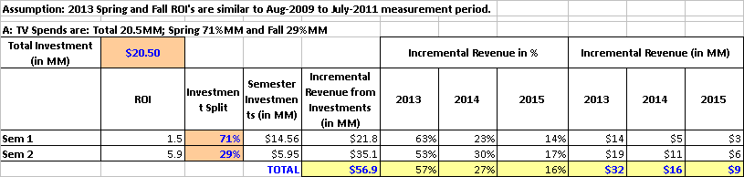
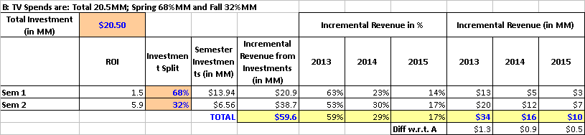
Projected Incremental Revenue from 2013 TV campaign
Assumption: ROIs will be similar as before.
Case A: TV Spend of 20.5MM [Spring 71% and Fall 29%] may generate $57MM ($32MM in 2013)
Case B: TV Spend of 20.5MM [Spring 68% and Fall 32%] may generate $59MM (+ $1.3MM in 2013)
Previous Nasonex TV analysis had study period between Aug-2009 to Jul-2011.
Minimum possible spends specified by GMC team was: Spring 14.5 MM and Fall: 6MM

Slide 2
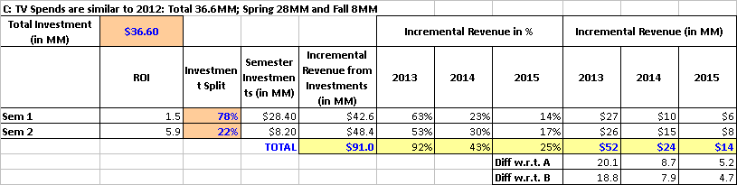
Projected Incremental Revenue from 2013 TV campaign (cont’d)
Assumption: ROIs will be similar as before.
Case C: TV Spend similar to 2012 level of 36.6MM [Spring 28.4MM and Fall 8.2MM] may generate $91MM ($52MM in 2013)
  Additional 20MM in 2013 when compared to Case A
  Additional 18.8MM in 2013 when compared to Case B
Previous Nasonex TV analysis had study period between Aug-2009 to Jul-2011.

Slide 3
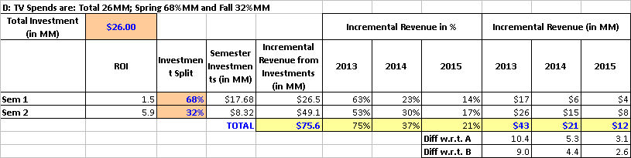
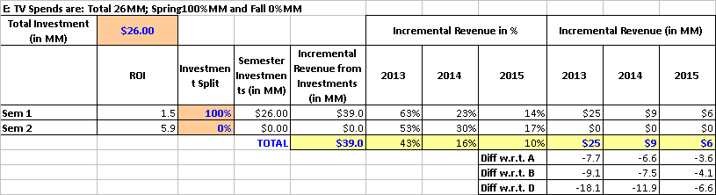
Projected Incremental Revenue from 2013 TV campaign
Assumption: ROIs will be similar as before.
Case D: TV Spend of 26MM [Spring 68% and Fall 32%] may generate $76MM ($43MM in 2013)
Case E: TV Spend of 26MM [Spring 100% and Fall 0%] may generate $39MM ($25MM in 2013)

Slide 4
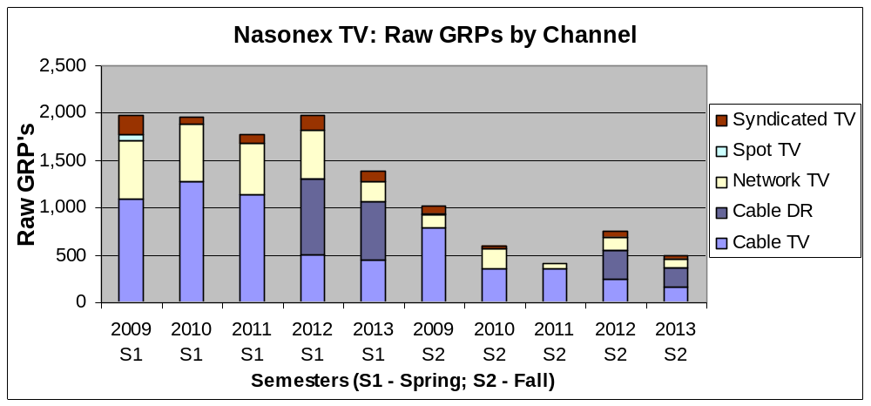
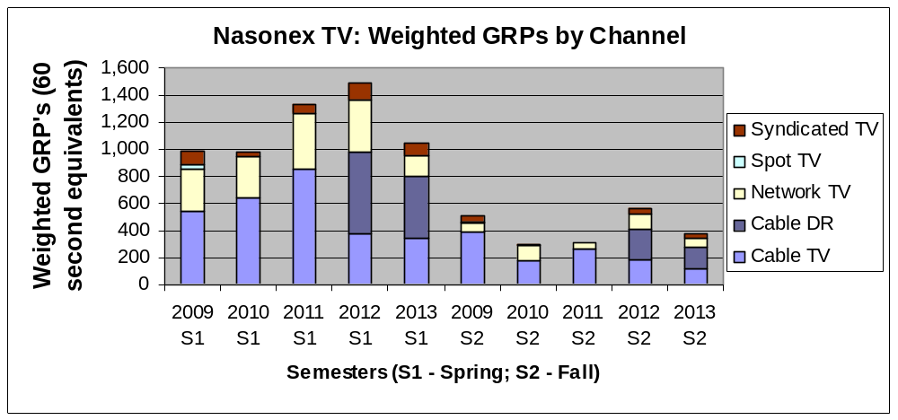
Comparison of TV ads between 2009 to 2012 vs. 2013(projected)
2013 has heavy Cable-DR component with lower spend in spring.
Previous Nasonex TV analysis had study period between Aug-2009 to Jul-2011.
The Spring total GRPs in weighted scale (i.e., 60 second equivalents) have slightly increased* in 2011 and 2012. 2013 is similar to 2009 and 2010.
Spend for Spring 2013 is almost ½ of Spring of 2011or 2012. Heavy “Cable – DR” in 2013 to increase the GRP with lower spend.
Spend in Fall is more or less constant across years (exception: 2012 fall spend and GRP were higher). “Cable-DR” is a heavy component for 2012 and 2013 Fall.
Given the differences in channel GRP distributions across years, the impacts per GRP may be different in 2013, but we do not know how much.
  If we assume that the impact per GRP is same like before, then the Spring 2013 ROI may double (from 1.5 to 3.0) since the spend is reduced by 50%.
  Given the unknowns, a safer assumption may be that ROI’s may be similar as before (instead of impact per GRP being same) and make projections on incremental revenue.
* There are some data quality issues being addressed for 2011 S1.

Slide 5
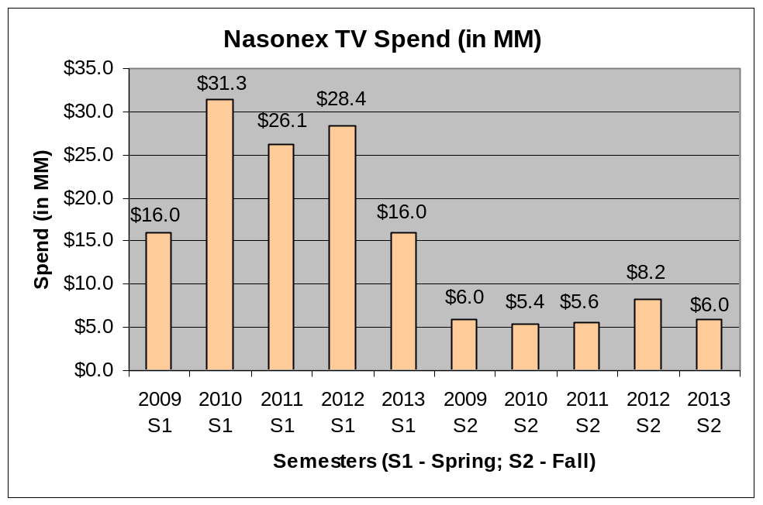
Comparison of TV spends between 2009 to 2012 vs. 2013(projected) (cont’d)
2013 has heavy Cable-DR component with lower spend in spring.

